Slide 1
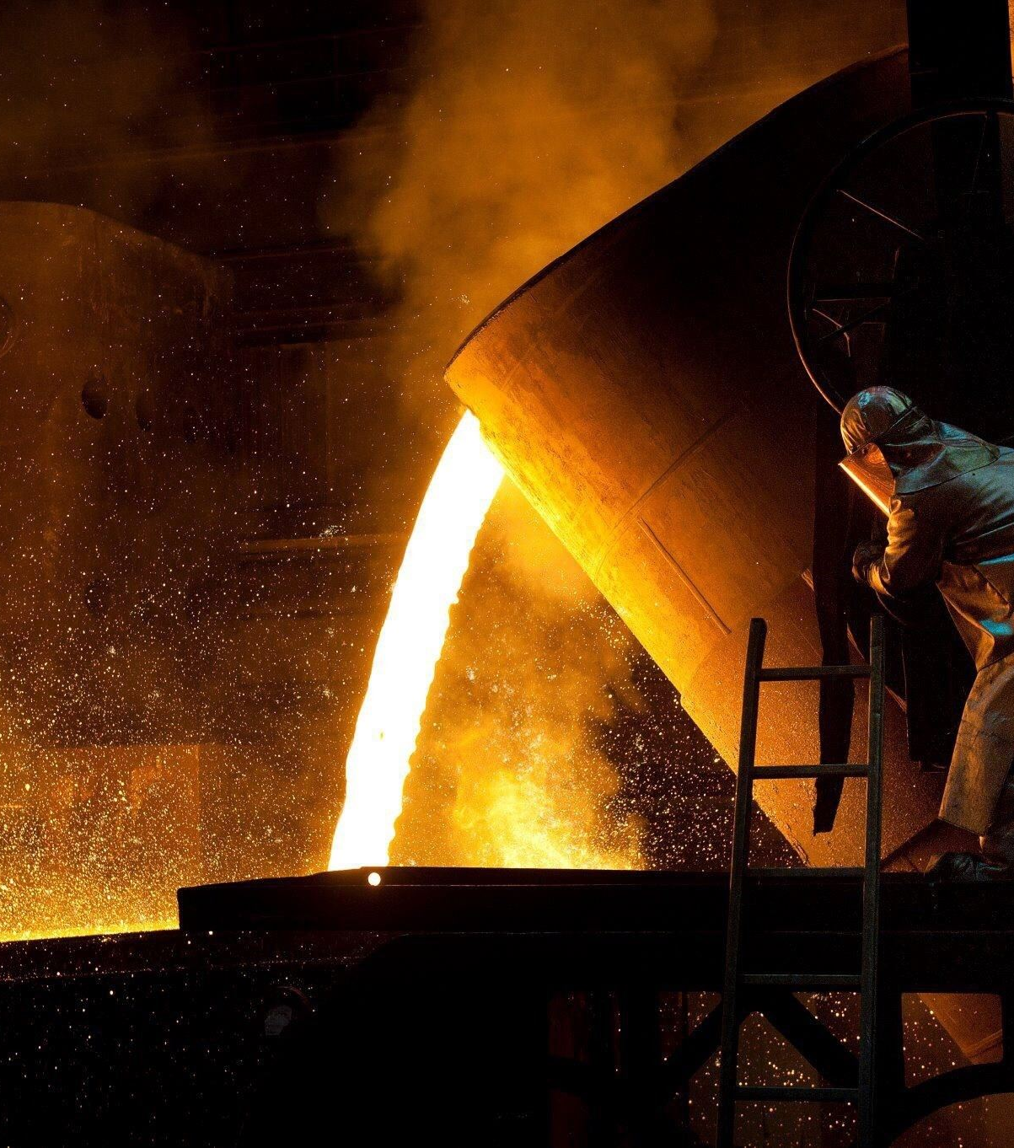

Manufacturing QA

Slide 2
How can LLM help with Manufacturing?
LLMs
Enhancing the efficiency of Product Design
Manufacturing Textbook
Pre-Trained with Few-shot Prompts
Analyzing Manufacturing Processes and Identifying Bottlenecks
RAG /API/Agents
Manufacturing Ontology/thesaurus
Fine-tuned
Providing Insights on Quality Control
Manufacturing Patents
Multi-modal
Evaluation Datasets
Manufacturing Research Papers
Evaluation Model
Evaluation Metrics

Slide 3
Large Language Models learning from manufacturing resources:
Large Language Models (LLMs) learning from manufacturing textbooks could have a significant impact on the industry, including:
1. Improved efficiency: LLMs can analyze and optimize manufacturing processes, identifying bottlenecks and proposing enhancements.
2. Enhanced product design: LLMs can assist in the design of new products and the improvement of existing ones, considering factors like materials, production processes, and cost.
3. Predictive maintenance: LLMs can analyze equipment sensor data to predict when maintenance is required, reducing downtime and increasing overall equipment effectiveness.
4. Quality control: LLMs can help detect defects and anomalies in products, enabling earlier intervention and minimizing waste.
5. Supply chain optimization: LLMs can analyze supply chain data to optimize logistics, reduce lead times, and improve inventory management.
6. Workforce augmentation: LLMs can assist human workers by providing real-time information and guidance, improving productivity and reducing errors.
7. Innovation acceleration: LLMs can help researchers and developers identify new manufacturing technologies and techniques, driving innovation and competitiveness.

Slide 4
Benefits
Improved Performance: an LLM fine-tuned on manufacturing textbooks is likely to perform better on tasks such as answering questions about manufacturing processes, generating technical documentation, or providing recommendations related to manufacturing operations.
Customization: Different manufacturing industries or companies may have unique terminology, processes, or standards. Fine-tuning an LLM on textbooks or data specific to a particular manufacturing domain or company allows for customization and tailoring of the model's knowledge and language to meet the specific needs of that context.

Slide 5
Manufacturing Dataset
ISE 515 Manufacturing Process- 745 QA( Review Questions and multiple choice questions)
Research Papers
Patents
Ontologies and Theasurus

Slide 6
Example QA
Question | Ground Truth Answer | GPT4 | Comments
12.13 What are some of the design recommendations for glass parts? | Answer. The guidelines include the following: (1) For applications requiring transparency, light transmittance, magnification, and similar optical properties, glass is likely to be the material of choice. (2) Glass parts should be subjected to compressive, not tensile loads. (3) Glass is brittle, so impact loading should be avoided. … | Minimize Stress Concentrators: … Ensure Even Thickness: … Use Safe Edge Profiles: …. Limit Large Flat Areas: … Consider Thermal Expansion: …. Opt for Annealed or Tempered Glass for Strength: … | Based on the provided correct answer, I would rate my previous response as a 3. My response covered several key points about designing glass parts, such as minimizing stress concentrators and ensuring even thickness, which aligns with using large radii on corners. However, it missed some specific points outlined in your provided correct answer…

Slide 7
RAG Embedding Fine-Tuning
model | is_hit
Openai | 0.8409
bge | 0.8539
fine_tuned | 0.8718
Fine tune local:BAAI/bge-small-enon 5 chapters of book A and validate on book B
model | epoch | steps | cos_sim-Accuracy@1 | cos_sim-Accuracy@3 | cos_sim-Accuracy@5 | cos_sim-Accuracy@10 | cos_sim-Precision@1 | cos_sim-Recall@1 | cos_sim-Precision@3 | cos_sim-Recall@3 | cos_sim-Precision@5 | cos_sim-Recall@5 | cos_sim-Precision@10 | cos_sim-Recall@10 | cos_sim-MRR@10 | cos_sim-NDCG@10 | cos_sim-MAP@100 | dot_score-Accuracy@1 | dot_score-Accuracy@3 | dot_score-Accuracy@5
bge | -1 | -1 | 0.4886 | 0.7094 | 0.7922 | 0.8945 | 0.4886 | 0.4886 | 0.2365 | 0.7094 | 0.1584 | 0.7922 | 0.0894 | 0.8945 | 0.6164 | 0.6832 | 0.6204 | 0.4886 | 0.7094 | 0.7922
fine_tuned | -1 | -1 | 0.6201 | 0.8231 | 0.8847 | 0.9318 | 0.6201 | 0.6201 | 0.2744 | 0.8231 | 0.1769 | 0.8847 | 0.0932 | 0.9318 | 0.7304 | 0.7798 | 0.7327 | 0.6201 | 0.8231 | 0.8847

Slide 8
GPT Fine tuning on QA
Train on the content of book A and test on book A’s review questions
Scale | Base Score (1-5) | Fine Tune Score (1-5)
Chapter 1 | 4.6458 | 4.6667
Chapter 1234 | 4.2875 | 4.4625

Slide 9
Journal Targets
Journal of Industrial Information Integration2023 Impact Factor: 15.7
IEEE Transactions on Industrial Informatics2023 Impact Factor: 12.3
Journal of Manufacturing Systems 2023 Impact Factor: 12.1

